Slide 1
TESTCASE MINIMISATION TOOL (TMT)

Slide 2
SUBMITTED BY: Kushagra Singhal (19BCE0716) Priyasha Thacker (19BCE2267) Manav Kulshrestha (19BCE0718)

Slide 3
OBJECTIVE
Software testing is most expensive phase of development. It becomes unfeasible to execute all the test cases. Test case minimization techniques are used to minimize the testing cost in terms of execution time, resources etc. The main purpose of test case minimization techniques is to remove test cases that become redundant and obsolete over time. Lastly, the purpose of this document is to communicate the system attributes of the Testcase Minimisation Tool software. These system attributes include reliability, availability, scalability, maintainability, and portability.

Slide 4
MOTIVATION
Every project begins with a requirement. Understanding the types of users and their requirements is the most important part of a project. As mentioned in the objective, it sometimes becomes unfeasible to execute all the testcases, there we opt for the Test case Minimisation Tool. It is outside the scope of this document to describe certain technology or the general problem with test cases. It is also outside the scope of this document to describe in any detail at all how certain mentioned standards or technologies work and operate. For future scope, the next version will allow the level of pessimism to be controlled at runtime

Slide 5
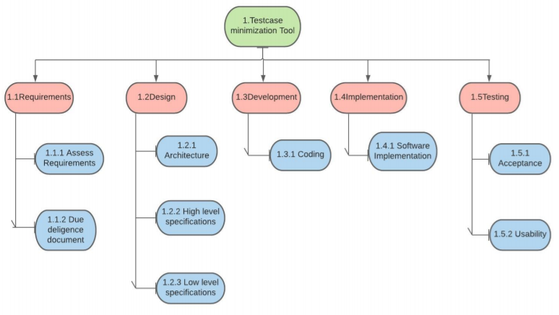
WORK BREAKDOWN STRUCTURE

Slide 6
PROCESS MODEL
We have chosen the Waterfall model for our project because the requirements are clear and easy to understand. The workflow is well and fine and the process aspects are clear.
This model is also referred to as a linear-sequential life cycle model. It is very simple to understand and use. In a waterfall model, each phase must be completed before the next phase can begin and there is no overlapping in the phases.

Slide 7
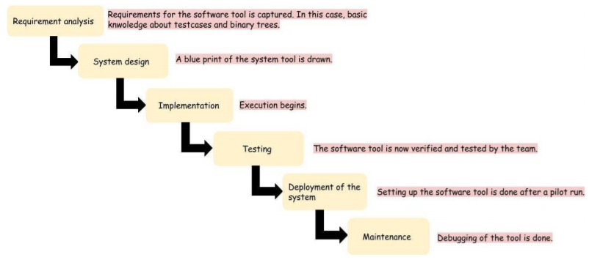
WATERFALL MODEL

Slide 8
WHY WATERFALL MODEL?
• It is a sequential approach which would be comfortable to work with.
• It is easy to manage due to the rigidity of the model.
• Each of its phase has some specific deliverables and a review process.
• Here, the phases are processed and completed one at a time.
• It works well for smaller projects where requirements are very well understood.
• The technology is easily understood and is not dynamic.
• There are no ambiguous requirements.
• The stages are clearly defined.
• The process and the results are well documented.

Slide 9
SOFTWARE SYSTEM ATTRIBUTES

Slide 10
RELIABILITY
Reliability in the Testcase Minimisation Tool will be ensured by thorough unit, milestone, and release testing. Comprehensive test scenarios and acceptance criteria will be established to reflect the necessary level reliability required of the Testcase Minimisation Tool. The all delivered source code will be thoroughly tested using the established test scenarios until the acceptance criteria are satisfied by the Testcase Minimisation Tool.

Slide 11
SECURITY
The Testcase Minimisation Tool will utilize Public / Private key encryption. This will provide test cases that are as secure as the public / private key encryption method is secure.

Slide 12
MAINTAINABILITY
The Testcase Minimisation Tool is written in C programming language. C promotes good design practices due to the inherent structure of a C program.
Along with the well-formed programming enforced by C, best practice development conventions will be enforced for the construction of the Testcase Minimisation Tool. Consistent variable naming conventions will be used by all the programmers. Consistent spacing will be used in the source code by all the programmers. The design of the source code will use the principles of Object Oriented Design and the source code will be programmed using Object Oriented Programming. Object-Oriented Design and Object-Oriented programming will make the code easier to understand.

Slide 13
PORTABILITY
It is safe to say that the implementation of the Testcase Minimisation Tool will be able to be ported to other system platforms that accept C/C++ applications with little to no changes required. It is not safe to say that the Testcase Minimisation Tool will execute properly on the other system platforms with little or no change. Significant changes to the Testcase Minimisation Tool may be required to ensure proper execution on other system platforms.

Slide 14
DESIGN APPROACH AND DETAILS

Slide 15
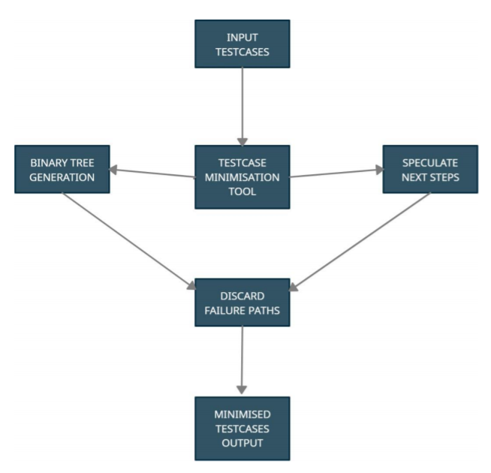
ARCHITECTURAL DIAGRAM

Slide 16
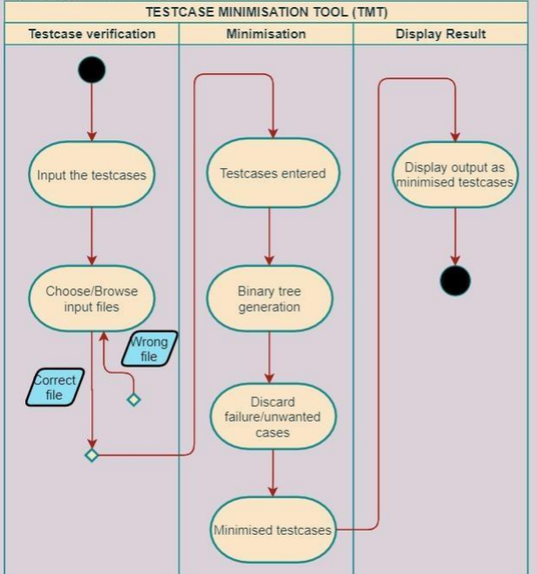
SWIMLANE ACTIVITY DIAGRAM

Slide 17
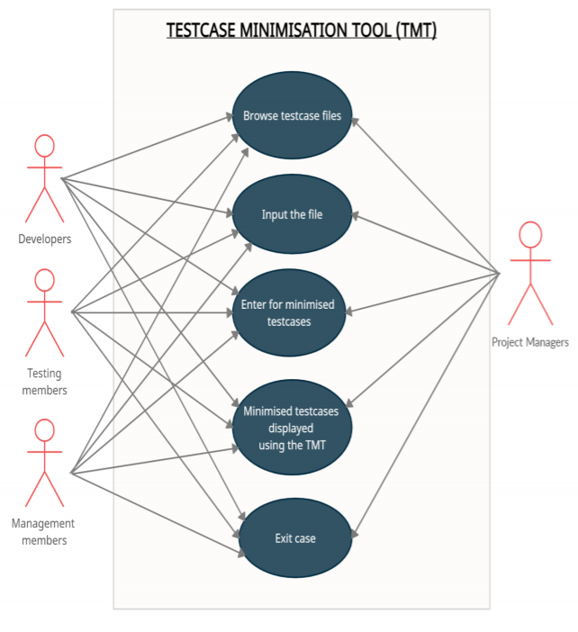
USE CASE DIAGRAM

Slide 18
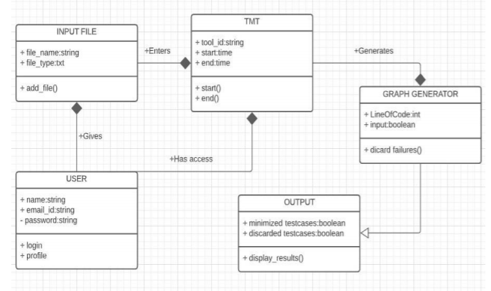
CLASS DIAGRAM

Slide 19
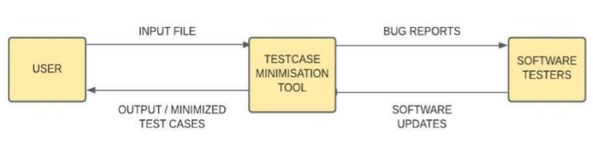
DATA FLOW DIAGRAM (LEVEL 0)

Slide 20
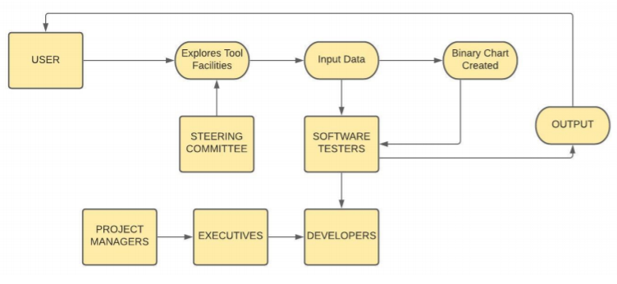
DATA FLOW DIAGRAM (LEVEL 1)

Slide 21
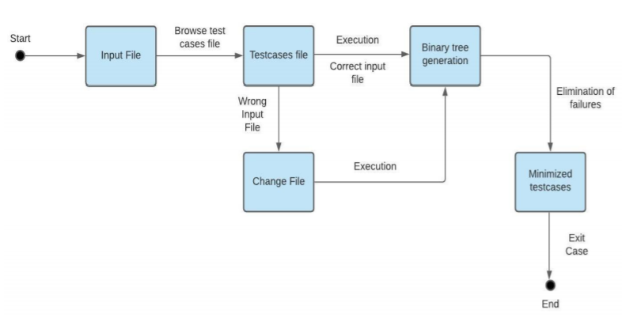
STATE TRANSITION DIAGRAM

Slide 22
SEQUENCE AND COLLABORATION DIAGRAMS

Slide 23
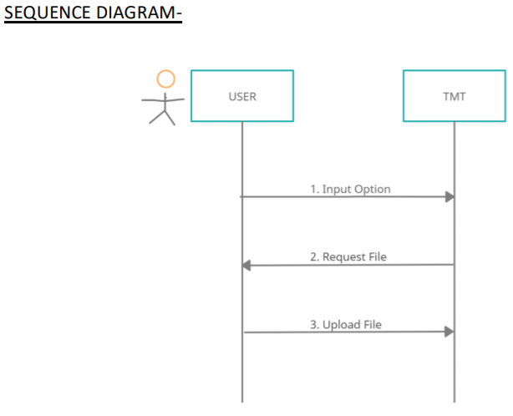
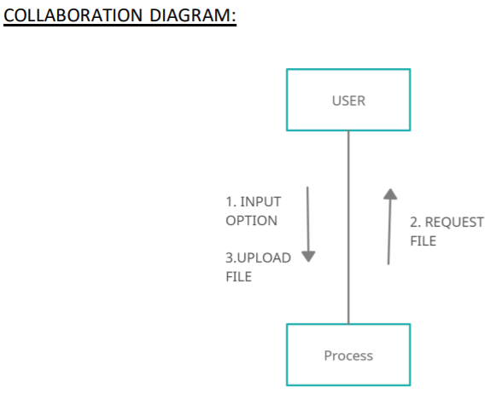
CONFIGURATION MODULE

Slide 24
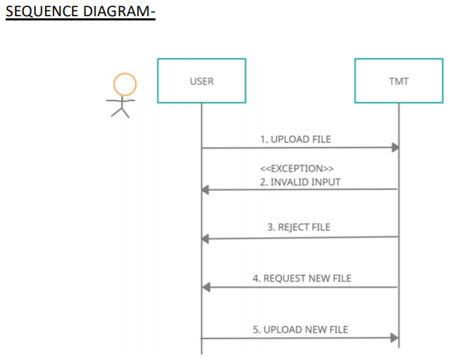
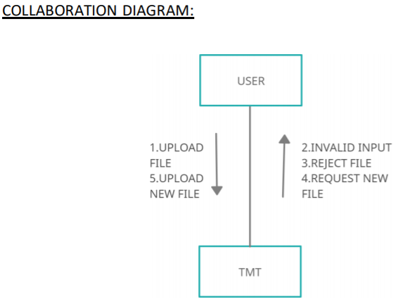
INPUT TESTCASES MODULE

Slide 25
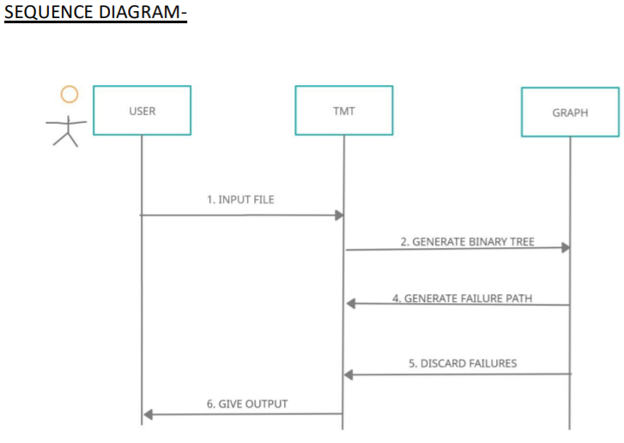
PROCESSING TESTCASES MODULE

Slide 26
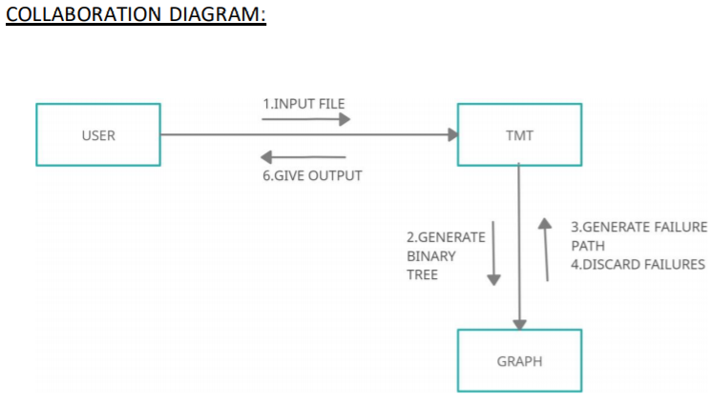
PROCESSING TESTCASES MODULE

Slide 27
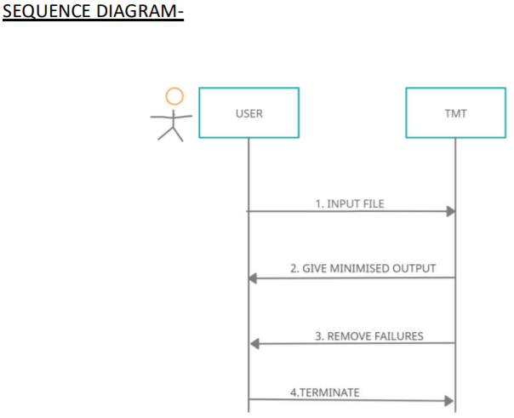
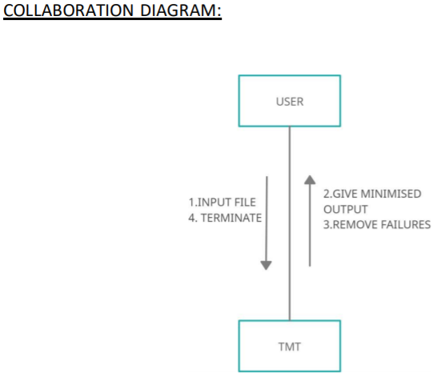
OUTPUT TESTCASES MODULE

Slide 28
SCHEDULES, TASKS AND MILESTONES

Slide 29
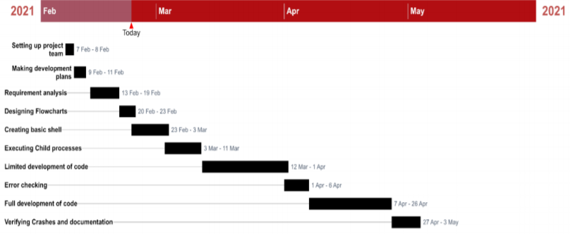
GANTT CHART

Slide 30
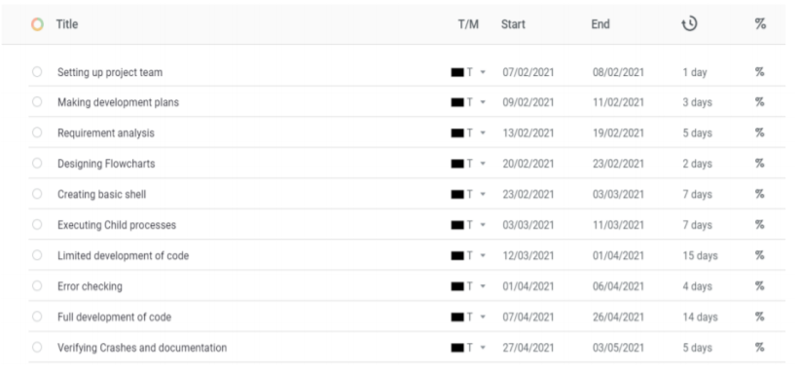
GANTT CHART

Slide 31
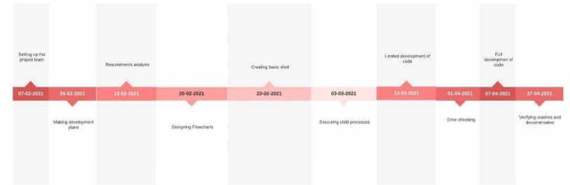
TIMELINE NETWORK

Slide 32
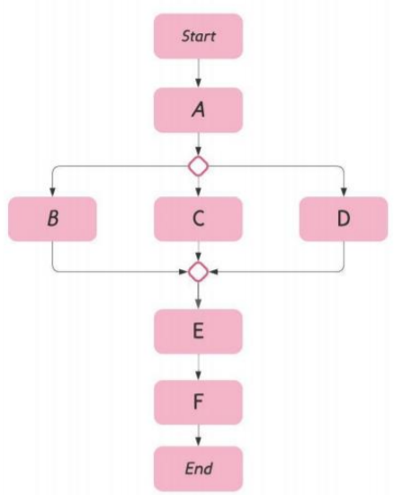
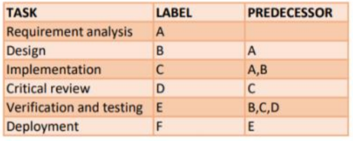
ACTIVITY NETWORK DIAGRAM (PROCESS BASED)

Slide 33
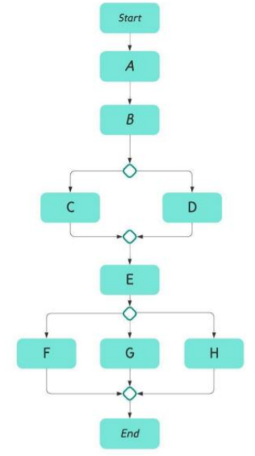
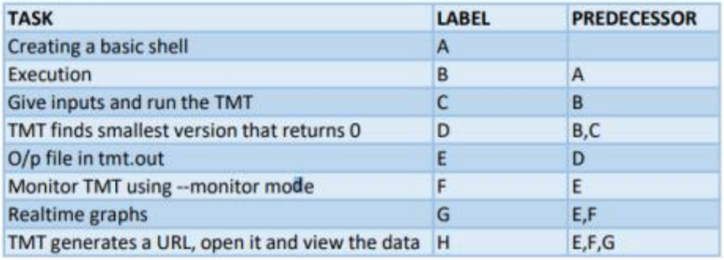
ACTIVITY NETWORK DIAGRAM (PRODUCT BASED)

